Slide 1
Objects and Classes
Mobile apps for iPhone & iPad
Learning & Development
http://academy.telerik.com

Slide 2
Table of Contents
Classes and Objects
What are Objects?
What are Classes?
Object Pointers
Classes in Objective-C
Declaring Class
Properties and methods
Init methods
Dynamic Binding

Slide 3
Table of Contents
OOP Principles
Inheritance
Protocols
Abstraction
Encapsulation

Slide 4
Classes and Objects
Modeling Real-world Entities with Objects

Slide 5
What are Objects?
Software objects model real-world objects or abstract concepts
Examples:
bank, account, customer, dog, bicycle, queue
Real-world objects have states and behaviors
Account' states:
holder, balance, type
Account' behaviors:
withdraw, deposit, suspend

Slide 6

What are Objects? (2)
How do software objects implement real-world objects?
Use variables/data to implement states
Use methods/functions to implement behaviors
An object is a software bundle of variables and related methods

Slide 7
Objects Represent
 checks
 people
 shopping list
…
 numbers
 characters
 queues
 arrays
Things from the real world
Things from the computer world

Slide 8
What is a Class?
The formal definition of class:
Definition by Google
Classes act as templates from which an instance of an object is created at run time. Classes define the properties of the object and the methods used to control the object's behavior.

Slide 9
Classes
Classes provide the structure for objects
Define their prototype, act as template
Classes define:
Set of attributes
Represented by variables and properties
Hold their state
Set of actions (behavior)
Represented by methods
A class defines the methods and types of data associated with an object

Slide 10
Classes – Example
Class Name
Attributes
(Properties and Fields)
Account
+owner: Person
+ammount: double
+suspend
+deposit: (double) sum
+withdraw: (double) sum
Operations
(Methods)

Slide 11
Objects
An object is a concrete instance of a particular class
Creating an object from a class is called instantiation
Objects have state
Set of values associated to their attributes
Example:
Class: Account
Objects: Ivan's account, Peter's account

Slide 12
Objects – Example
Object
Class
clarkAccount
+Owner="Clark Kent"
+Ammount=200.0
Account
+owner: Person
+ammount: double
Object
bruceAccount
+suspend
+deposit: (double) sum
+withdraw: (double) sum
+Owner="Bruce Wayne"
+Ammount=100000000.0
Object
tonyAccount
+Owner="Tony Stark"
+Ammount=100000000.9

Slide 13
Object Types and App Memory

Slide 14
App Memory
Every MAC OS X/iOS application has two places to hold the values of the app (variables and stuff)
The Stack and the Heap
The stack is a fixed-sized stack data structure that holds primitive types and object pointers
Only the address, not the object itself
The heap is the place where all objects live
Their addresses are stored on the stack

Slide 15
Primitive Object Types
Some objects in Obj-C are passed by value
They live on the stack and are destroyed when out of scope
Their value is copied when passed as a parameter to a method, or when assigned to another object
NSInteger, NSUInteger, CGFloat, etc…
char, int, float, double, etc…

Slide 16
Reference Object Types
Other objects are passed by reference
They live in the Heap, and only their address in the Heap is passed
Not copied, only their addresses (references)
NSObject, NSArray, NSString, etc…
Instances of custom classes are also stored on the heap

Slide 17
Primitive and Reference Types
Live Demo

Slide 18


Classes in Objective-C
Using Classes and their Class Members

Slide 19

Classes in Objective-C
Classes – basic units that compose programs
Implementation is encapsulated (hidden)
Classes in Objective-C can contain:
Fields (member variables)
Properties
Methods
Every class in Objective-C has two files
Public interface file (the .h file)
Implementation file (the .m file)

Slide 20
Fields
Fields are data members of a class
Can be variables and constants (read-only)
All fields are private (they can be accessed only from the implementation of the class)
Accessing a field doesn’t invoke any actions of the object
Just accesses its value
Most of the cases they are hidden from the world
They live only in the implementation part

Slide 21
Accessing Fields
Constant fields can be only read
Variable fields can be read and modified
Usually properties are used instead of directly accessing variable fields

Slide 22
Creating Classes in Objective-C
Classes in Objective-C consists of two separate files - ClassName.h and ClassName.m
ClassName.h contains the public interface of the class
Members that are accessible from other objects
ClassName.m contains the implementations of the public interface and private members

Slide 23
Creating Classes
Live Demo

Slide 24
Properties
Properties look like fields
Have name and type
Can contain code, executed when accessed
Declared using the @property directive

Slide 25
Properties
Usually used for encapsulation
They control the access to the data fields
They validate the given input values
Can contain more complex logic
Like parsing or converting data

Slide 26
Properties
Every property has two components called accessors
Getter
Called when the property is requested
double x = shape.x;
Setter
Called when the property value is changing
shape.x = 4.5;

Slide 27

Properties (2)
Properties can be either:
Read-only
Write-only
Read-write
By default they are read-write
@interface
@property (readonly) int size;
@property int capacity;
@end

Slide 28
Properties
Live Demo

Slide 29
Properties: Getters and Setters
Properties provide a getter and a setter methods
Used to execute some code when assigning a value or getting the value of the property
By default:
The setter method is called setPropertyName
The getter method is with the name of the property
@property int capacity;
-(int) capacity{ … }
-(void) setCapacity { … }

Slide 30
Properties: Getters and Setters
Live demo

Slide 31
Instantiating Objects

Slide 32
Instantiating Objects
Objective-C provides two ways of instantiating objects
Using init methods
Using factory methods
Person *p = [[Person alloc] init];
Person *p = [[Person alloc] initWithFirstname: @"Peter"];
Person *p = [Person person];
Person *p = [Person personWithFirstname: @"Peter"];

Slide 33
Instantiating Objects
Objective-C provides two ways of instantiating objects
Using init methods
Using factory methods
Person *p = [[Person alloc] init];
Person *p = [[Person alloc] initWithFirstname: @"Peter"];
Person *p = [Person person];
Person *p = [Person personWithFirstname: @"Peter"];
Both are equally used and in best case both should be present

Slide 34
Init Methods

Slide 35
Init Methods
Init methods are used to create objects
They are regular methods that have a special meaning in modern MAC/iOS apps
ARC checks for methods with prefix "init" and treat their result differently

Slide 36
Init Methods Template
Init methods have a special template to follow:
-(id) init
{
self = [super init];
if (self)
{
//the parent is instantiated properly and can
//continue instance specific stuff..
}
return self;
}

Slide 37
Multiple Init Methods
ARC checks for methods with prefix "init"
All of the following are valid init methods:
@interface Person: NSObject
@ends

Slide 38
Multiple Init Methods
ARC checks for methods with prefix "init"
All of the following are valid init methods:
@interface Person: NSObject
@ends
-(id) init;
The default init method
Produces objects without parameters

Slide 39
Multiple Init Methods
ARC checks for methods with prefix "init"
All of the following are valid init methods:
@interface Person: NSObject
@ends
-(id) init;
-(id) initWithFullname: (NSString *) fullname;
init method that takes a single parameter
Handles the role of "method overloading"

Slide 40
Multiple Init Methods
ARC checks for methods with prefix "init"
All of the following are valid init methods:
@interface Person: NSObject
@ends
-(id) init;
-(id) initWithFullname: (NSString *) fullname;
-(id) initWithFirstname: (NSString *) fname
andLastName: (NSString *) lname;
init method that takes two parameters
The same as the others

Slide 41
Multiple Init Methods
Live Demo

Slide 42
Factory Methods

Slide 43
Factory Methods
Factory methods are no more than hidden init methods
They are class methods (the message is sent to the class, instead of to a concrete object)

Slide 44
Factory Methods (2)
By concept, factory methods' identifiers start with the name of the class, i.e.
@interface Person: NSObject
+(id) person;
+(id) personWithFirstname: (NSString *) fname;
@end
@implementation
+(id) personWithFirstname: (NSString *) fname
{
Person *p = [[Person alloc] init];
p.firstname = fname;
return p;
}
@end

Slide 45
Factory Meth0ds
Live Demo

Slide 46

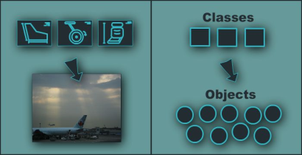
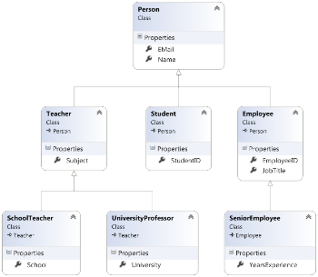
Fundamental Principles of OOP
Object-Oriented
Notes:
(c) 2006 National Academy for Software Development - http://academy.devbg.org*
46##

Slide 47
Fundamental Principles of OOP
Inheritance
Inherit members from parent class
Abstraction
Define and execute abstract actions
Encapsulation
Hide the internals of a class
Polymorphism
Access a class through its parent interface
47

Slide 48
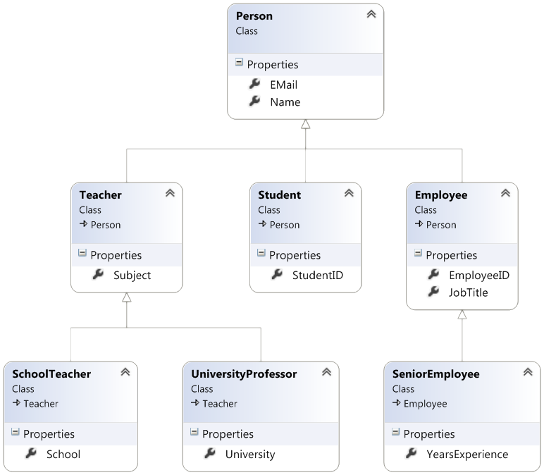
Inheritance
Notes:
(c) 2006 National Academy for Software Development - http://academy.devbg.org*
48##

Slide 49
Classes and Protocols
Classes define attributes and behavior
Fields, properties, methods, etc.
Methods contain code for execution
Protocols define a set of operations
Empty methods and properties, left to be implemented later
@interface Shape: NSObject
@end
@implementation Shape
@end
@protocol Figure
@end

Slide 50
Inheritance
Inheritance allows classes to inherit characteristics from an existing parent (super) class
Attributes (fields and properties)
Operations (methods)
A child class can extend the parent class
Add new fields and methods
Redefine methods (modify existing behavior)
A class can conform to a protocol by providing implementation for its methods
50

Slide 51
Types of Inheritance
Inheritance terminology
base class /
parent class
derived class
inherits
class
conforms to
protocol
51

Slide 52

Inheritance – Benefits
Inheritance has a lot of benefits
Extensibility
Reusability (code reuse)
Provides abstraction
Eliminates redundant code
Use inheritance for buidling is-a relationships
E.g. person is-a mammal
Don't use it to build has-a relationship
E.g. person has-a name
52
Notes:
(c) 2006 National Academy for Software Development - http://academy.devbg.org*
52##

Slide 53
Inheritance
Child classes implicitly gain all members from the super class
All fields, methods, properties
Some members are inaccessible (hidden)
The class whose methods are inherited is called base (parent) class
The class that gains new functionality is called derived (child) class

Slide 54
Inheritance – Example
Base class
Person
+Name: NSString
+Address: NSString
Derived class
Derived class
Employee
Student
+Company: NSString
+Salary: double
+School: NSString

Slide 55
Class Hierarchies
Inheritance leads to a hierarchies of classes and / or protocols in an application:
Game
SinglePlayerGame
MultiplePlayersGame
Minesweeper
Solitaire
BoardGame
…
…
Chess
Backgammon
55

Slide 56
Inheritance in Objective-C
A class can inherit only one base class
E.g. NSMutableArray derives from NSArray
A class can conform to several protocols
This is Obj-C’s form of multiple inheritance
Shape conforms to Movable and Drawable
56

Slide 57

How to Define Inheritance?
Specify the name of the base class after the name of the derived (with colon)
@interface Person: NSObject
@property (strong, nonatomic) NSString* firstname;
@property (strong, nonatomic) NSString* lastname;
@end
@interface Ninja: Person
@property int rank;
@end

Slide 58
How to Define Inheritance?
Specify the name of the base class after the name of the derived (with colon)
@interface Person: NSObject
@property (strong, nonatomic) NSString* firstname;
@property (strong, nonatomic) NSString* lastname;
@end
@interface Ninja: Person
@property int rank;
@end
Inherits properties firstname and lastname from Person

Slide 59
How to Define Inheritance?
Specify the name of the base class after the name of the derived (with colon)
@interface Person: NSObject
@property (strong, nonatomic) NSString* firstname;
@property (strong, nonatomic) NSString* lastname;
@end
@interface Ninja: Person
@property int rank;
@end
Inherits properties firstname and lastname from Person
Adds new property

Slide 60
Simple Inheritance Example
@interface Person: NSObject
-(instancetype) initWithFirstname: (NSString *) fname
andLastname: (NSString *) lname;
-(void) introduce;
-(void) walk;
@end
@implementation Person
@synthesize firstname; @synthesize lastname;
-(instancetype) initWithFirstname: (NSString *) fname
andLastname: (NSString *) lname{
}
-(void) introduce{
}
-(void) walk{
}
@end

Slide 61
Simple Inheritance Example
@interface Ninja: Person
@property int rank;
-(instancetype) initWithRank: (int) rank;
-(void) fight;
@end
@implementation Ninja
@synthesize rank;
-(instancetype) initWithRank: (int) rank{
self = [super initWithFirstname: @"[Unknown]"
andLastname: @"[Unknown]"];
self.rank = rank;
return self;
}
-(void) walk{
}
-(void) fight{
}
@end

Slide 62
Simple Inheritance Example
@interface Ninja: Person
@property int rank;
-(instancetype) initWithRank: (int) rank;
-(void) fight;
@end
Adds new property – rank
Adds new method – fight
@implementation Ninja
@synthesize rank;
-(instancetype) initWithRank: (int) rank{
self = [super initWithFirstname: @"[Unknown]"
andLastname: @"[Unknown]"];
self.rank = rank;
return self;
}
-(void) walk{
}
-(void) fight{
}
@end

Slide 63
Simple Inheritance Example
@interface Ninja: Person
@property int rank;
-(instancetype) initWithRank: (int) rank;
-(void) fight;
@end
Adds new property – rank
Adds new method – fight
@implementation Ninja
@synthesize rank;
-(instancetype) initWithRank: (int) rank{
self = [super initWithFirstname: @"[Unknown]"
andLastname: @"[Unknown]"];
self.rank = rank;
return self;
}
-(void) walk{
}
-(void) fight{
}
@end
Overwrites the method from the parent

Slide 64


Simple Inheritance
Live Demo

Slide 65
Inheritance: Important Aspects
In Objective-C there is no multiple inheritance
Yet, a class can conform to multiple protocols
Class members are also inherited
Init methods are inherited
Inheritance is transitive relation
If C is derived from B, and B is derived from A, then C inherits A as well

Slide 66
Inheritance: Important Features
When a derived class extends its base class
It can freely add new members
Cannot remove derived ones
Declaring new members with the same name or signature overwrites the inherited ones
A class may not provide implementation to some methods
Derived classes can provide the implementation

Slide 67



Abstraction
Notes:
(c) 2006 National Academy for Software Development - http://academy.devbg.org*
67##

Slide 68

Abstraction
Abstraction means ignoring irrelevant features, properties, or functions and emphasizing the relevant ones ...
... relevant to the given project
With an eye to future reuse in similar projects
Abstraction helps managing complexity
"Relevant" to what?
68

Slide 69
Abstraction (2)
Abstraction is something we do every day
Looking at an object, we see those things about it that have meaning to us
We abstract the properties of the object, and keep only what we need
E.g. students get "name" but not "color of eyes"
Allows us to represent a complex reality in terms of a simplified model
Abstraction highlights the properties of an entity that we need and hides the others
69

Slide 70

Abstraction in .NET
In Objective-C object-oriented programming abstraction is achieved in several ways:
Protocols
Inheritance
Control
+click()
ButtonBase
+Color : long
Button
RadioButton
CheckBox
70

Slide 71
Protocols
An protocol defines a set of messages (methods) that given object should perform
Also called "contract" for providing a set of operations
Defines abstract behavior
Protocols provide abstractions
You invoke the abstract actions
Without worrying how it is internally implemented
71

Slide 72
Protocols(2)
Protocols describe a prototype of group of methods (operations) or properties
Can be conformed by a given class
Define only the prototypes of the operations
No concrete implementation is provided
Can be used to define abstract data types
Can not be instantiated
Can contain optional and required members

Slide 73
Protocols – Example
@protocol Shape
@property double x;
@property double y;
-(void) moveToX:(double) x andY: (double) y;
-(double) calculateSurface;
-(double) calculateArea;
@end
@protocol Resizable
@property double width;
@property double height
-(void) resizeWidth: (double) width;
-(void) resizeHeight: (double) height;
-(void) resizeWidth: (double) width
andHeight: (double) weighty;
@end

Slide 74
Protocols Implementation
Classes can conform to one or several protocols
@interface Rectangle : NSObject<Shape>
-(instancetype) initWithX: (double) x
y: (double) y
width: (double) width
andHeight: (double) height;
@end;
Implementer classes must conform all methods and properties of the protocol

Slide 75
Interface Implementation (2)
@interface Rectangle: NSObjet<Shape, Resizable>
// Rectangle specific declarations
@end
@implementation Rectangle
@synthesize x; @synthesize y;
@synthesize width; @synthesize height;
-(void) moveToX:(double) x
andY: (double) y { /* implementation */ }
-(double) calculateSurface { /* implementation */ }
-(double) calculateArea { /* implementation */ }
-(void) resizeWidth: (int) width { /* implementation */ }
-(void) resizeHeight: (int) height { /* implementation */ }
-(void) resizeWidth: (int) width
andHeight: (int) weighty { /* implementation */ }
@end

Slide 76

Protocols and Implementations
Live Demo

Slide 77


Encapsulation
Notes:
(c) 2006 National Academy for Software Development - http://academy.devbg.org*
77##

Slide 78
Encapsulation
Encapsulation hides the implementation details
Class announces some operations (methods) available for its clients – its public interface
All data members (fields) of a class should be hidden
Accessed via properties (read-only and read-write)
No interface members should be hidden
78

Slide 79
Encapsulation – Example
Data fields are private
Init methods and accessors are defined (getters and setters)
Person
-_name : NSString
-_age : int
+initWith: (NSString*) name
andAge: (int) age
+name : NString
+age : int
79

Slide 80
Encapsulation in .NET
Fields are always declared private
They cannot be public anyway
Init methods are almost always declared public
Protocol members are always public
Non-interface members are declared private / protected
80

Slide 81
Encapsulation – Benefits
Ensures that structural changes remain local:
Changing the class internals does not affect any code outside of the class
Changing methods' implementation does not reflect the clients using them
Encapsulation allows adding some logic when accessing client's data
E.g. validation on modifying a property value
Hiding implementation details reduces complexity → easier maintenance
81

Slide 82
Encapsulation
Live Demo
Notes:
(c) 2006 National Academy for Software Development - http://academy.devbg.org*
82##

Slide 83
Object-Oriented Programming with Objective-C
http://academy.telerik.com

